Slide 1









My Number Interactive Notebook
$$×$$
$$\frac{1}{2}$$
$$÷$$
$$+$$
$$−$$
$$\frac{3}{5}$$
$$7$$
Name
Class
Teacher
Term 1 Semester 1
$$5^{2}$$
$$\sqrt{9}$$
1

Slide 2
Contents
Glossary or Formula Page
Page
Date
Description
2
3

Slide 3
Tasks
24
7
30
Essential Question
Questions
Notes
Summary

Slide 4
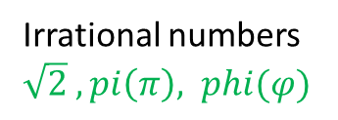
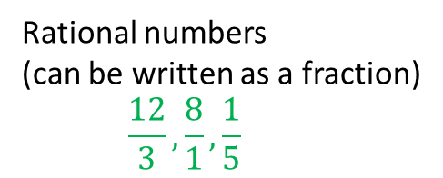
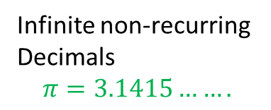
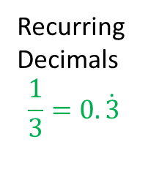
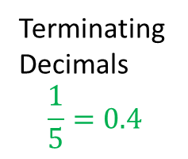
24
7
30
Date
Rational Numbers
EQ – Describe the difference between rational and irrational numbers.
What is a rational number?
Real Numbers
Rational numbers
(can be written as a fraction)
$$\frac{12}{3}, \frac{8}{1}, \frac{1}{5}$$
Irrational numbers
$\sqrt{2} ,pi\left(π\right), phi(φ)$
Terminating
Decimals
$$\frac{1}{5}=0.4$$
Recurring
Decimals
$$\frac{1}{3}=0.\dot{3}$$
Infinite non-recurring
Decimals
$$π=3.1415…….$$

Slide 5
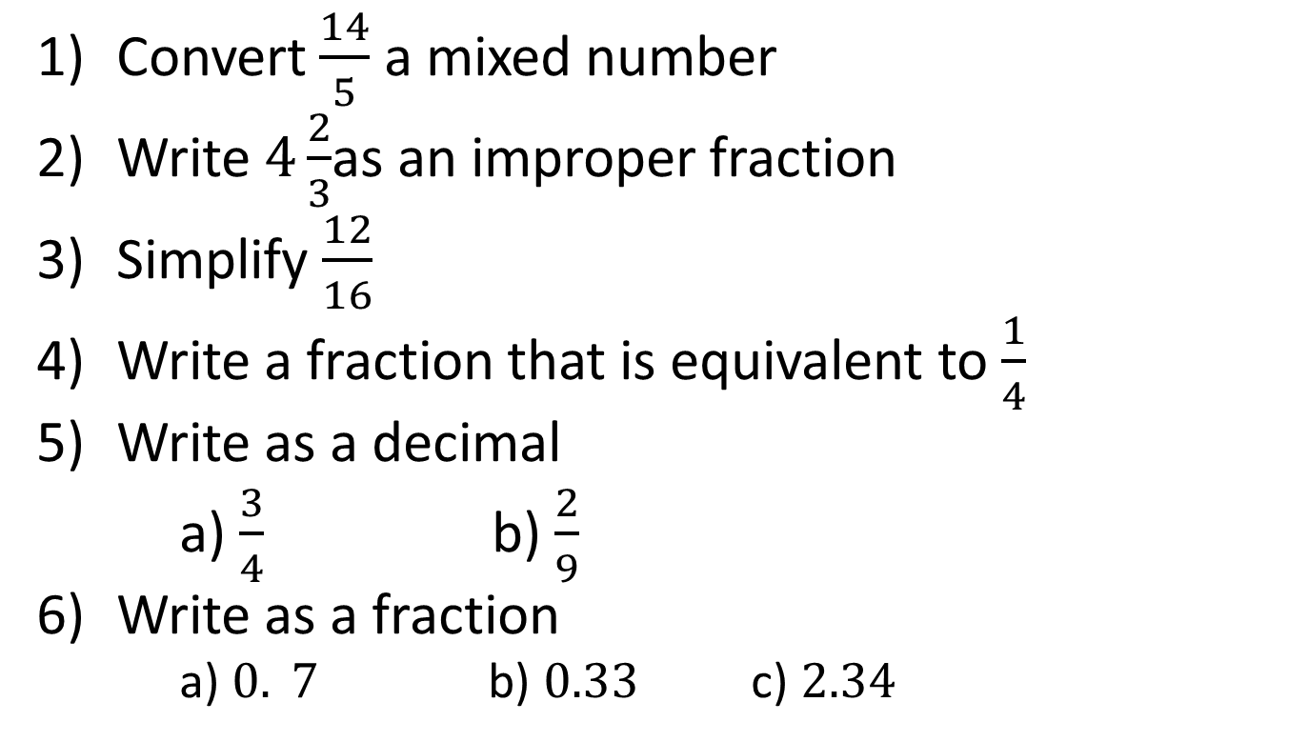
Task – Fraction Revision
Convert $\frac{14}{5}$ a mixed number
Write $4\frac{2}{3}$as an improper fraction
Simplify $\frac{12}{16}$
Write a fraction that is equivalent to $\frac{1}{4}$
Write as a decimal
a) $\frac{3}{4}$ b) $\frac{2}{9}$
Write as a fraction
a) $0. 7$ b) $0.33$ c) $2.34$

Slide 6
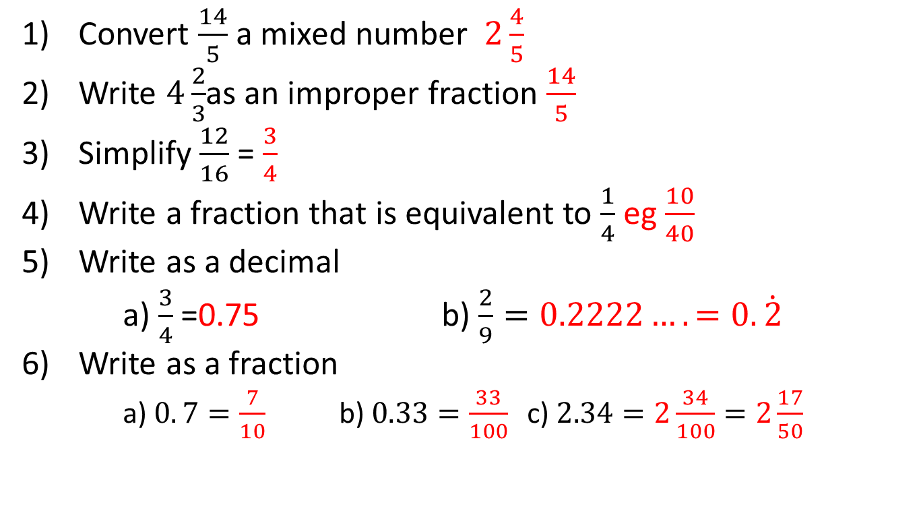
Task – Fraction Revision
Convert $\frac{14}{5}$ a mixed number $2\frac{4}{5}$
Write $4\frac{2}{3}$as an improper fraction $\frac{14}{5}$
Simplify $\frac{12}{16}$ = $\frac{3}{4}$
Write a fraction that is equivalent to $\frac{1}{4}$ eg $\frac{10}{40}$
Write as a decimal
a) $\frac{3}{4}$ =0.75 b) $\frac{2}{9}=0.2222….=0.\dot{2}$
Write as a fraction
a) $0. 7=\frac{7}{10}$ b) $0.33=\frac{33}{100}$ c) $2.34=2\frac{34}{100}=2\frac{17}{50}$

Slide 7
Notes Review
24, 7 ,30
Date
Title
Essential question
Notes complete
Notes complete with colour and diagrams
Questions completed
Contents page filed in
Formula page filled in

Slide 8
Homework
Review your notes and write a summary answering the essential question.

